Slide 1
Status of Statistics Curricula in Canada
(a graphical study)
Sotirios Damouras & Sohee Kang
U of T Scarborough

Slide 2
Data Sources
Stats program enrolments/graduates: Postsecondary Student Information System (PSIS) survey, from Statistics Canada (StatCan)
Microdata available through StatCan’s RTRA
Stats program curricula: collected from universities’ calendars
Many thanks to Olivia Rennie (UTSC NeuroSci BSc) for her help
All data & code available through GitHub
https://github.com/damouras/SoSC

Slide 3
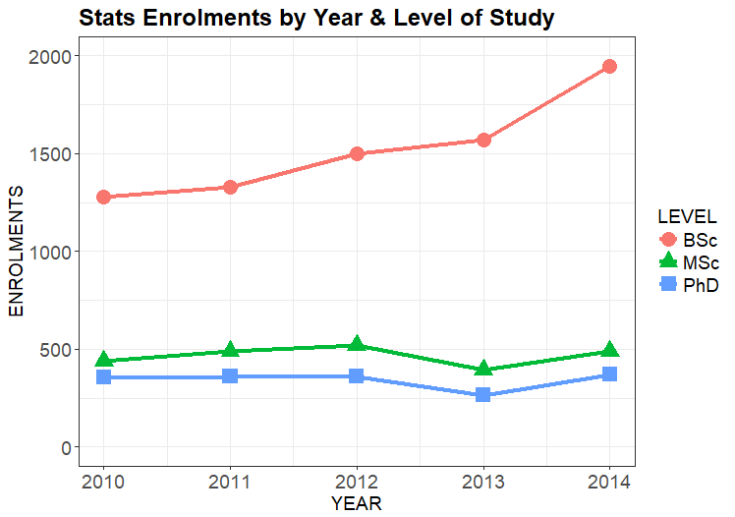
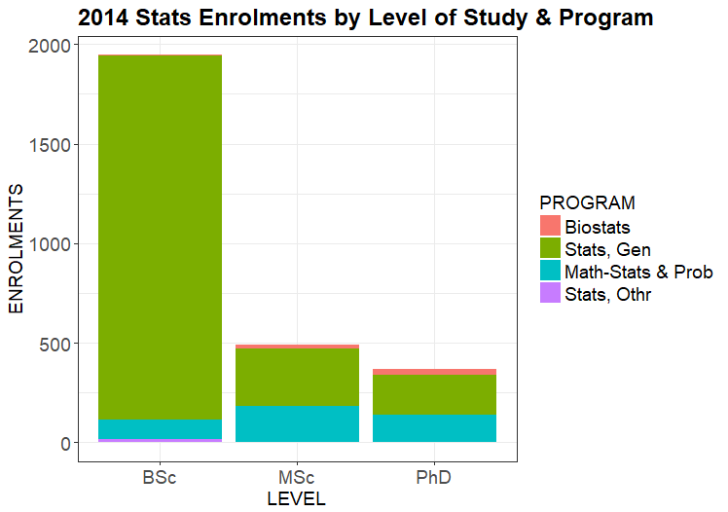
Stats Programs Vital Statistics
52% increased BSc
enrolments (`10 to `14)
Majority of BSc in
General Statistics
Notes:
Growth of
Twice as many BSc than MSc graduates! Contrast to US :
twice as many BSc grads per capita in Canada ( (375/36)/(1700/321) ~ 2)
Similar total grads ( (600/36)/(5000/321) ~ 1)

Slide 4
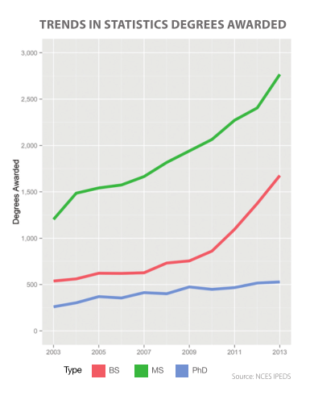
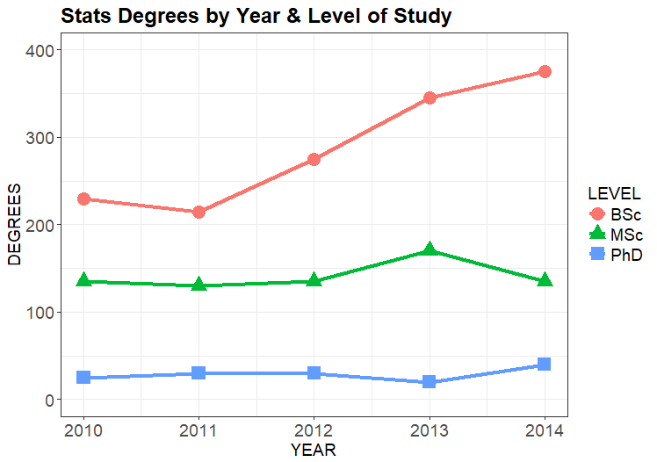
Stats Programs Vital Statistics
Different from US
(where MSc > BSc)
>2 times more BSc
than MSc+PhD grads
CANADA
USA
(reproduced from 2014 ASA Curriculum Guidelines
for undergraduate programs in statistical Science)

Slide 5
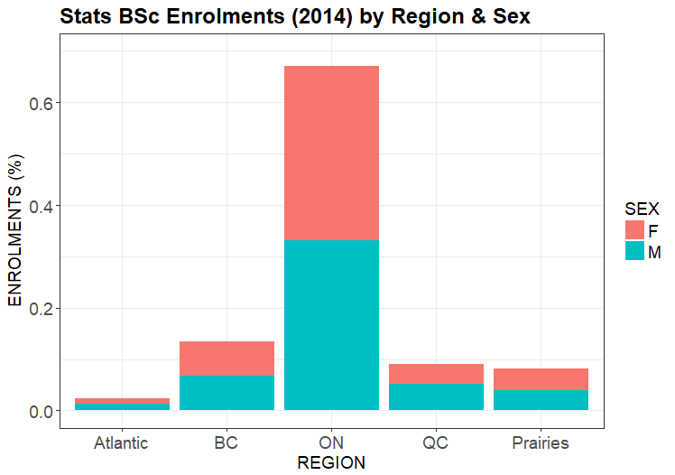
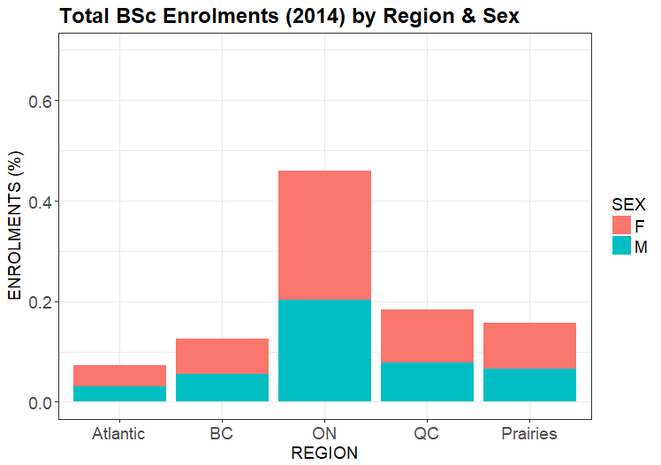
Stats BSc Enrolment Breakdown
Gender Parity!!
(F/M = 970/975)
ON has relatively more Stats BSc’s;
Atlantic/QC/Prairies have less
Stats BSc
All BSc

Slide 6
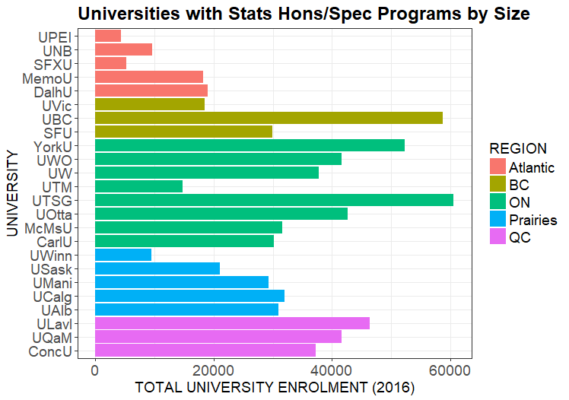
Stats Curricula - Target Population
Only considered (pure) Statistics Honours/Specialist BSc programs
Excludes Minor, Major, 3-yr BA/BSc, etc
Excludes programs with not focused on Statistics (e.g. Probability & Statistics, Mathematical Statistics, etc)
Analyzed programs from n=24 Universities

Slide 7
Curriculum Data
Variable | Description | Format | Values
Code | Course code | TEXT | e.g. STAB22H3
Title | Course title | TEXT | e.g. Statistics I
Credits | This can be tricky, as universities can have different conventions. To keep the variable numeric, use 1 for 2-semester courses (i.e. like UofT's Y courses), .5 for 1-semester courses (UofT's H-courses, should be most common option), and other fractions where applicable (e.g. a half-semester course would have .25 credits) | NUMERIC | e.g. 1.0
Description | Course description | TEXT | Copy-paste from calendar , no pre-reqs or exclusions
Discipline |  | CATEGORICAL | One or more of: MATH, STAT, COMP, OTHR
Level | Effectively, the year the course is offered in. It is usually included in the course code ( I think UTSC is the only University in North America using A,B,C,D) | CATEGORICAL | One or more of : 1, 2, 3, 4
Type | Include electives as courses with partial info (i.e. field can be missing) | CATEGORICAL | One of: R, E, FE
Category | One or more course types from: MT: Mathematics PT: Probability Theory (incl. Stochastic Processes) CS: Computing ST: Statistical Theory SM: Statistical Methodology SP: Statistical Practice OT: Other | CATEGORICAL | One or more of: MT, PT, CS, ST, SM, SP, OT
Comments | Use this field for for anything out of the ordinary that you want to point out | TEXT

Slide 8
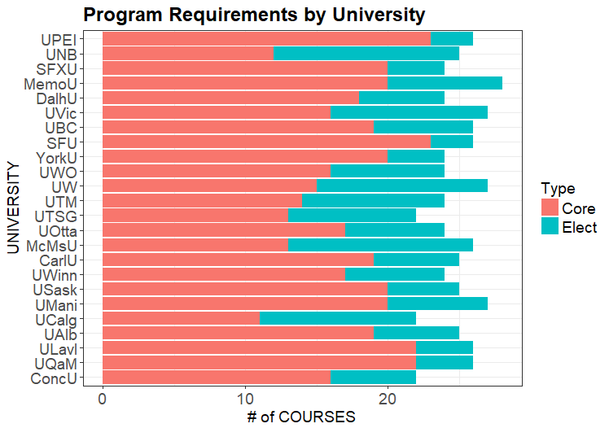
Number of Courses
25 semester courses required on average; with most programs between 24-26 (i.e. 12 - 13 full-year equivalents, or 72 - 78 credit hours)
70% of courses specified (core)
Most ranging between 60% - 80%

Slide 9
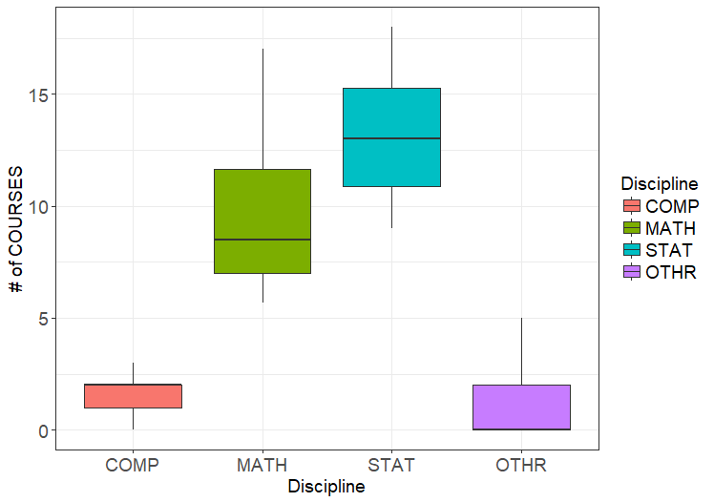
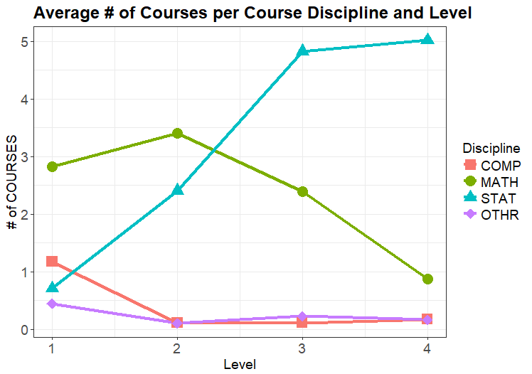
Breakdown of Courses per Discipline
Too many MATH courses
(exclude PT from STAT)
Too little STATS courses
in 1st Year (mostly none)

Slide 10
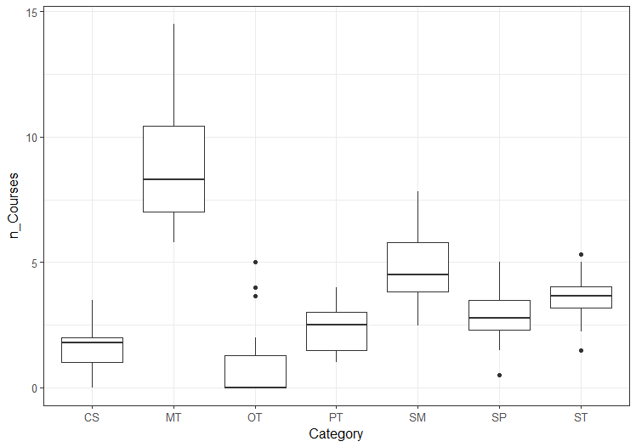
Breakdown of Courses per Learning Outcome

Slide 11
Conclusions
Train Stats Hons/Spec BSc’s primarily for the workplace (rather than for graduate study)
Offer more Stat courses (at expense of Math courses)
Offer Stat courses early on (especially 1st year)
Focus (new or existing) courses on Statistical Practice

